Slide 1
Welcome! Database Development and Design
Developing and Design of databases using SQL Server

Slide 2
Agenda
Session 1
Session 2
Session 3
Session 4
Homework discussion
Built-In functions
Workshop
Scalar functions
Workshop
Table valued functions
Inline table-valued function
Multi-statement table-valued functions
Workshop
Knowledge check (Quiz, Discussion, Homework)
Session 5

Slide 3
Agenda
Session 1
Session 2
Session 3
Session 4
Session 5
Homework discussion
Stored procedures
Workshop
Error handling
Workshop
Knowledge check (Quiz, Discussion, Homework)
Summary

Slide 4
Homework discussion

Slide 5
Built-In functions

Slide 6
Built-In functions - Declarations
Scalar variable
Table variable
Temp table
DECLARE @EmployeeId INT
SET @EmployeeId = 1
DECLARE @EmployeeList TABLE
(EmployeeId int, FirstName NVARCHAR(100), LastName NVARCHAR(100));
INSERT INTO @EmployeeList
SELECT Id, FirstName, LastName from dbo.Employee
CREATE TABLE #EmployeeList
(EmployeeId int, FirstName NVARCHAR(100), LastName NVARCHAR(100));
INSERT INTO #EmployeeList
SELECT Id, FirstName, LastName from dbo.Employee

Slide 7
Built-In functions – String functions
LEFT(), RIGHT(), LEN()
SUBSTRING
SUBSTRING ( expression ,start , length )
REPLACE
REPLACE ( string_expression , string_pattern , string_replacement )
Example:
select FirstName,
LEFT(FirstName,3) as LeftFunction,
RIGHT(FirstName,3) as RightFunction,
LEN(FirstName) as LenFunction,
SUBSTRING(FirstName,1,3) as SubstringFunction,
REPLACE(FirstName,'Ale','X-') as ReplaceFunction
from dbo.Employee

Slide 8
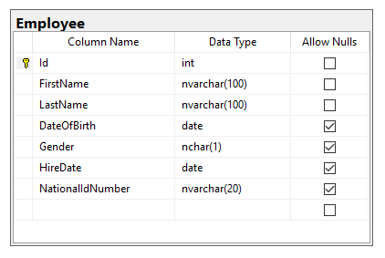
Built-in functions - Workshop
Declare scalar variable for storing FirstName values
Assign value ‘Aleksandar’ to the FirstName variable
Find all Employees having FirstName same as the variable
Declare table variable that will contain EmployeeId and DateOfBirth
Fill the table variable with all Female employees
Declare temp table that will contain LastName and HireDate columns
Fill the temp table with all Male employees having First Name starting with ‘A’
Retrieve the employees from the table which last name is with 7 characters

Slide 9
Scalar functions

Slide 10
Scalar functions
User-defined functions are routines that accept parameters, perform an action, such as a complex calculation, and return the result of that action as a value.
Scalar functions allow modular programming
Scalar functions return a single data value of the type defined in the RETURNS clause
How to create:
CREATE FUNCTION FunctionName (@ParaleterList [datatype])
RETURNS [datatype]
AS
BEGIN
DECLARE @OutputVariable [datatype]
SELECT @OutputVariable = ...
RETURN @OutputVariable
END
Notes:
https://docs.microsoft.com/en-us/sql/relational-databases/user-defined-functions/user-defined-functions?view=sql-server-2017

Slide 11
Scalar functions - example
Session 4 – 01 Scalar function.sql
Example for scalar function:
CREATE FUNCTION dbo.fn_EmployeeFullName (@EmployeeID int)
RETURNS NVARCHAR(2000)
AS
BEGIN
DECLARE @Result NVARCHAR(2000)
SELECT @Result = e.FirstName + N' ' + e.LastName
FROM dbo.Employee e
WHERE Id = @EmployeeID
RETURN @Result
END
How to call:
select dbo.fn_EmployeeFullName(1)
Notes:
https://docs.microsoft.com/en-us/sql/relational-databases/user-defined-functions/user-defined-functions?view=sql-server-2017

Slide 12
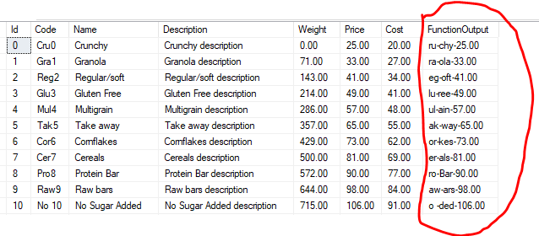
Scalar functions - Workshop
Declare scalar function (fn_FormatProductName) for retrieving the Product description for specific ProductId in the following format:
Second and Third character from the Code
-
Last three characters from the Name
-
Product Price

Slide 13
Table-valued functions
Inline, Multi-statement

Slide 14
Table-valued functions
allow modular programming
Allows multiple input parameters
return table on output
Definition types:
Inline table-valued function
Multi-statement table-valued functions
Notes:
https://docs.microsoft.com/en-us/sql/relational-databases/user-defined-functions/user-defined-functions?view=sql-server-2017

Slide 15
Table-valued functions
Inline table-valued function
How to define:
Example:
Session 4 – 02 Inline TVF.sql
CREATE FUNCTION FunctionName (@ParaleterList [datatype])
RETURNS TABLE
AS
RETURN
SELECT ColumnList
FROM Table
Notes:
https://docs.microsoft.com/en-us/sql/relational-databases/user-defined-functions/user-defined-functions?view=sql-server-2017

Slide 16
Table-valued functions
Multi-statement table-valued function
Allows multiple SQL Statements in the function body
How to define:
Example:
Session 4 – 03 Multi-statement TVF.sql
CREATE FUNCTION FunctionName (@ParaleterList [datatype])
RETURNS @TableVariable table (Column1, Column2,...)
AS
BEGIN
INSERT INTO @TableVariable
SELECT Column1,Column2,...
FROM TABLE1
RETURN
END
Notes:
https://docs.microsoft.com/en-us/sql/relational-databases/user-defined-functions/user-defined-functions?view=sql-server-2017

Slide 17
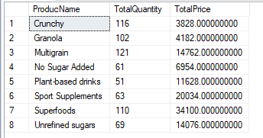
Functions - Workshop
Create multi-statement table value function that for specific BusinessEntity and Customer will return list of products sold, together with the total quantity sold and total price per product
Example resultset:

Slide 18
Knowledge check
Quiz, Discussion, Homework

Slide 19
Quiz
Can we assign multiple values to scalar variable?
a. Yes
b. No
Which SQL function is used to determine number of characters in the string?
a. LEFT
b. STRING
c. STRING_SIZE
d. LEN
Can we return single value in table-valued function
a. Yes
b. No

Slide 20
Quiz
Can we return two records in scalar function?
a. Yes
b. No
Can we insert data in some table by using table valued function?
a. Yes
b. No
Can we insert data in some table by using scalar function?
a. Yes
b. No

Slide 21
Quiz
What is the main difference between temp table and table variable?
What is the main difference between inline and multi-statement table valued functions?

Slide 22
Homework

Slide 23
Homework requirement 1/3
Declare scalar variable for storing FirstName values
Assign value ‘Antonio’ to the FirstName variable
Find all Students having FirstName same as the variable
Declare table variable that will contain StudentId, StudentName and DateOfBirth
Fill the table variable with all Female students
Declare temp table that will contain LastName and EnrolledDate columns
Fill the temp table with all Male students having First Name starting with ‘A’
Retrieve the students from the table which last name is with 7 characters
Find all teachers whose FirstName length is less than 5 and
the first 3 characters of their FirstName and LastName are the same

Slide 24
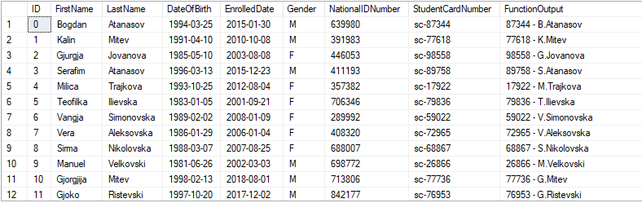
Homework requirement 2/3
Declare scalar function (fn_FormatStudentName) for retrieving the Student description for specific StudentId in the following format:
StudentCardNumber without “sc-”
“ – “
First character of student FirstName
“.”
Student LastName

Slide 25
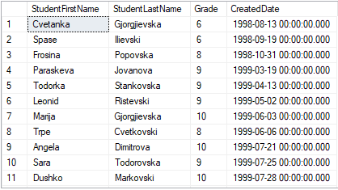
Homework requirement 3/3
Create multi-statement table value function that for specific Teacher and Course will return list of students (FirstName, LastName) who passed the exam, together with Grade and CreatedDate
Example resultset:

